Slide 1
Placement Management system
Database management system project
Designed using MySQL
Presented by: Harsha Vardhan Polukonda
Department of computer science and engineering

Slide 2
Project Overview
• A database project to organize student placement information.
• stores departments, students, applications, companies, placement drives, interviews, results, and skills.
• uses MySQL queries to insert, retrieve, update, and manage data.
• supports reporting through joins, subqueries, views, and aggregate functions.
• the database design follows the approved ER diagram.

Slide 3
Problem Statement
• placement information may be maintained in separate spreadsheets or files.
• finding student applications and company drive details can take time.
• tracking interview rounds and final placement results requires organized records.
• repeated or inconsistent data can make reporting difficult.
• a centralized relational database helps manage this information consistently.

Slide 4
Project Objectives
• design a relational database based on the ER diagram.
• store student and department details.
• maintain company and placement drive information.
• connect applications, interviews, and placement results.
• manage student skills through a many-to-many mapping table.
• practice MySQL concepts from basic queries to advanced database objects.

Slide 5
Project Scope
Included
Not included in this version
• MySQL database design
• 9 tables from the ER model
• manual primary keys
• relationship reference columns
• SQL queries, views, procedures, functions, triggers, and transactions.
• frontend application
• backend web services
• user login screens
• automated resume screening
• additional entities outside the approved ER diagram

Slide 6
Proposed Database Solution
• use MySQL as the relational database management system.
• divide information into related tables to reduce unnecessary repetition.
• use primary keys to identify records uniquely.
• use matching ID columns to represent relationships between tables.
• use SQL queries to retrieve meaningful placement information.

Slide 7
Technology And Tools
Database
Development tool
Project storage
MySQL relational database for data definition and manipulation
MySQL workbench query editor schema and table inspection
GitHub repository scripts readme and ER diagram image
The current project is database-focused and runs through SQL in MySQL.

Slide 8
Database Workflow
1
2
3
Department & students
Companies & drives
Applications
4
5
6
Interviews
Placement results
Reports & queries
Records are connected through the ID columns defined in the relational design.

Slide 9
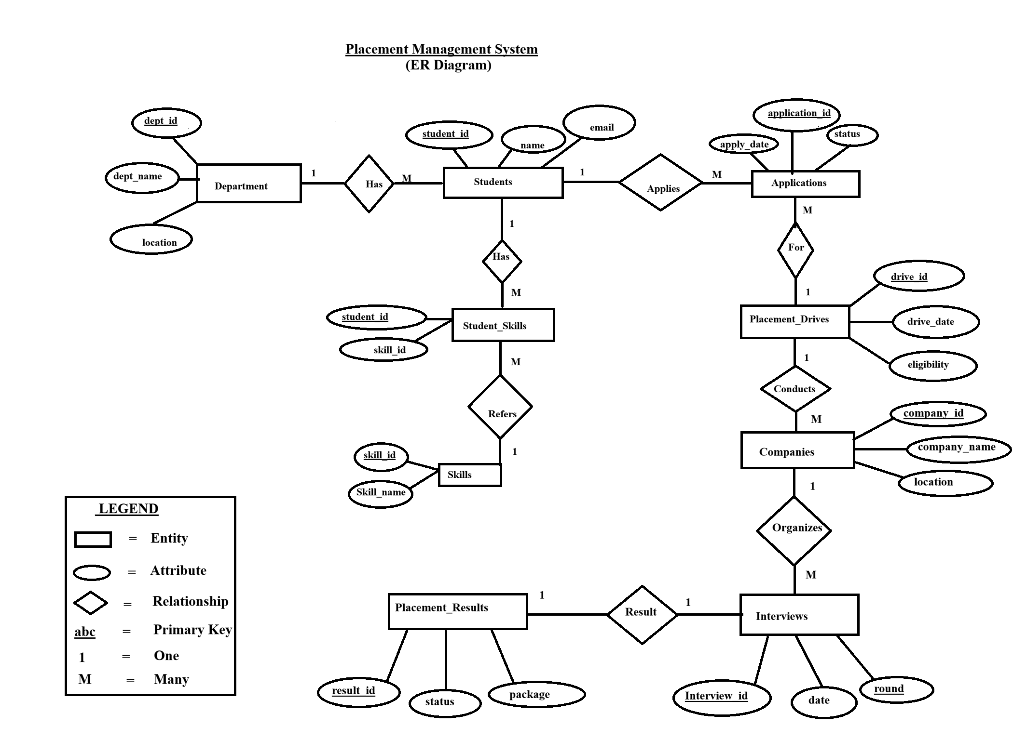

Slide 10
Entities In The ER Model
Department
Students
Applications
Dept_id (PK), dept_name, location
Student_id (PK), name, email, dept_id
Application_id (PK), apply_date, status, student_id, drive_id
Placement_drives
Companies
Interviews
Drive_id (PK), drive_date, eligibility, company_id
Company_id (PK), company_name, location
Interview_id (PK), date, round, drive_id
Placement_results
Skills
Student_skills
Result_id (PK), status, package, interview_id
Skill_id (PK), skill_name
Student_id, skill_id (composite PK)

Slide 11
Relationships And Cardinality
• department 1 : many students
• students 1 : many applications
• applications many : 1 placement_drives
• placement_drives many : 1 companies
• companies 1 : many interviews (as represented in the ER model)
• placement_results 1 : 1 interviews
• students 1 : many student_skills
• student_skills many : 1 skills

Slide 12
Relational Schema – Student Records
Department
Students
Applications
Dept_id —
primary key
dept_name
location
Student_id — primary key
name
email
dept_id — department reference
Application_id — primary key apply_date
Status
student_id — student reference
drive_id — drive reference
Student and application records are connected using student_id.

Slide 13
Relational Schema – Companies And Drives
Companies
Placement_drives
Company_id — primary key
company_name
location
Drive_id — primary key
drive_date
eligibility
company_id — company reference
One company can be associated with multiple placement drives.

Slide 14
Relational Schema – Interviews And Results
Interviews
Placement_results
Interview_id — primary key
Date
Round
drive_id — drive reference
Result_id — primary key
Status
Package
interview_id — unique reference
Each placement result is linked to one interview in this design.

Slide 15
Skills And Student Skills
Skills
Student_skills
Skill_id — primary key
skill_name
Student_id
skill_id
composite primary key: (student_id, skill_id)
Student_skills resolves the many-to-many relationship between students and skills.

Slide 16
SQL Operations Used
DDL
DML
TCL
Create table
alter table
create view
create index
Insert
Select
Update
delete
Start transaction
Commit
Rollback
savepoint
SQL helps define structures, manipulate records, and control transactions.

Slide 17
Database Programming Objects
Views
Stored procedures
Functions
Save a reusable select query.
example: student_application_view
Execute a reusable set of SQL statements.
example: get_all_students()
Return a value from a reusable routine.
example: get_total_students()
These objects reduce repeated query writing and organize database logic.

Slide 18
Triggers And Transaction Control
Triggers
Transactions
Run automatically when an insert or update event occurs.
example: validate application status before insert.
Control a group of database changes.
commit: save changes
rollback: cancel uncommitted changes
savepoint: mark a rollback point
Transactions should be practiced with transactional tables such as InnoDB.

Slide 19
Conclusion
The placement management system demonstrates how a relational database can organize placement-related records.
Key learning outcomes
Database design • primary keys • SQL queries • joins • subqueries • views • procedures • functions • triggers • transactions

Slide 20


